Slide 1
Code Golf
The Zen of writing bad code

Slide 2


Slide 3
Code Golf
“Code golf is a type of recreational computer programming competition in which participants strive to achieve the shortest possible source code that solves a certain problem.” -Wikipedia

Slide 4
Why Code Golf?
Unique puzzle solving
Code challenges
Finding creative solutions
Clever ways to abuse PowerShell
Code interview practice
Uses an existing skill set in a new way

Slide 5
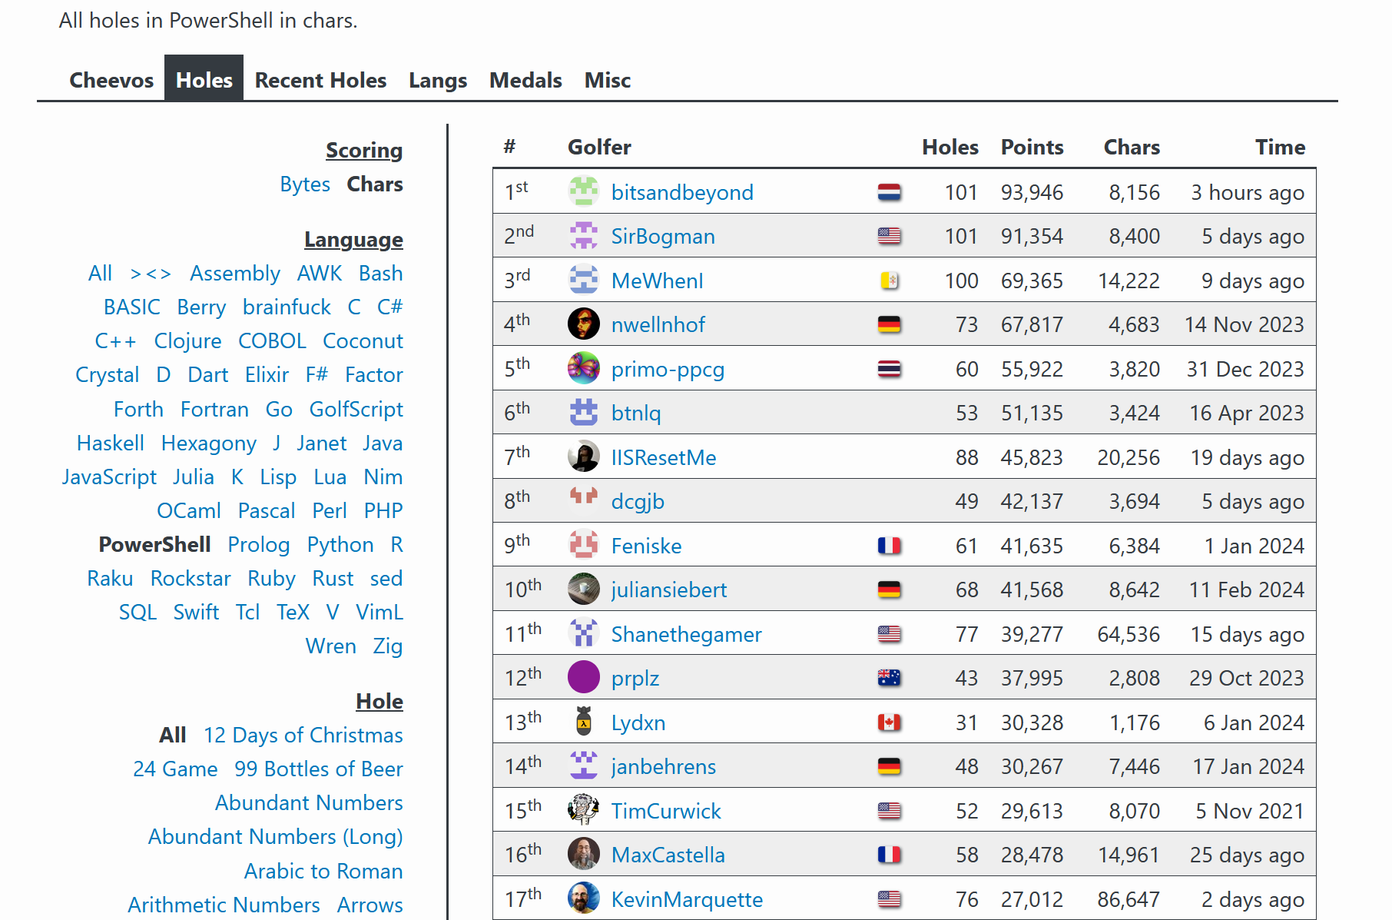
https://code.golf/
37 languages: PowerShell, Python, C#, SQL, bash,…
70+ holes: FizzBuzz, Roman Numerals, Prime Numbers, State Abbreviations,…
Code execution and validation
Leader board

Slide 6
Disclaimer
Just because you can do something, it doesn’t mean you should.
Professional code values readability, uses well named variables, logical, reusable, testable, avoids obscure syntax and clever code
Code golf is none of those things

Slide 7
Show me the code
Basic tips and tricks

Slide 8

About Kevin Marquette
PowerShellExplained.com Founder
Microsoft PowerShell MVP 2018-2022
2018 PowerShell Community Hero
SoCal PowerShell User Group Founder
@KevinMarquette
KevMar@gmail.com
github.com/KevinMarquette/CodeGolfPresentation

Slide 10

Thank you

